Slide 1
Lecture 10.1 The basic incentive problem

Slide 2
The Basic Incentive Problem
The basic incentive problem is one that have already discussed in the lectures on organisational design and the allocation of decision rights. There is an agency problem created by delegating decision rights.
The interests of the owners and employees is not always aligned
More generally, the interest of principals and agents is not generally aligned.
Consider the following example of AssemCo. from the readings.
The owner wants the employees to put in higher effort and work diligently.
Employees prefer to take breaks and work at a more leisurely pace.
How do you motivate an individual worker over a one-week period when they can potentially put in 40 hours of effort?

Slide 3
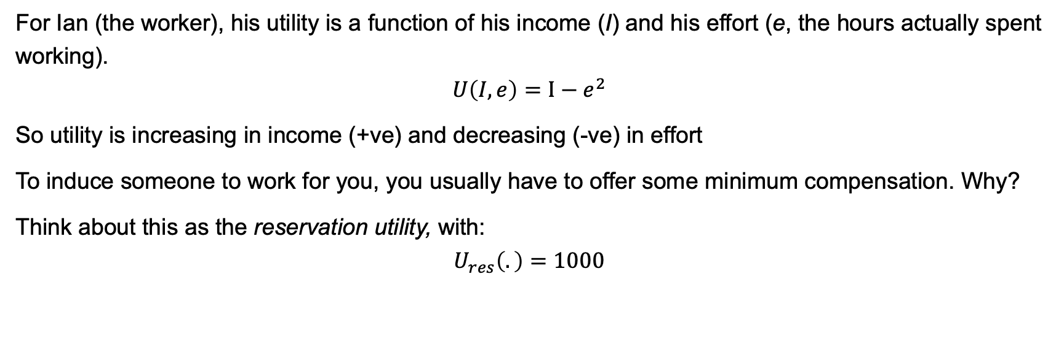
The Basic Incentive Problem
For Ian (the worker), his utility is a function of his income (I) and his effort (e, the hours actually spent working). $$U\left(I, e\right)=I−e^{2}$$
So utility is increasing in income (+ve) and decreasing (-ve) in effort
To induce someone to work for you, you usually have to offer some minimum compensation. Why?
Think about this as the reservation utility, with:
$$U_{res}\left(.\right)=1000$$

Slide 4
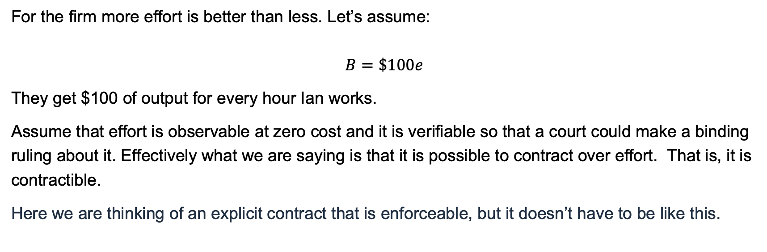
The Basic Incentive Problem
For the firm more effort is better than less. Let’s assume:
$$B=\$100e$$
They get $100 of output for every hour Ian works.
Assume that effort is observable at zero cost and it is verifiable so that a court could make a binding ruling about it. Effectively what we are saying is that it is possible to contract over effort. That is, it is contractible.
Here we are thinking of an explicit contract that is enforceable, but it doesn’t have to be like this.

Slide 5
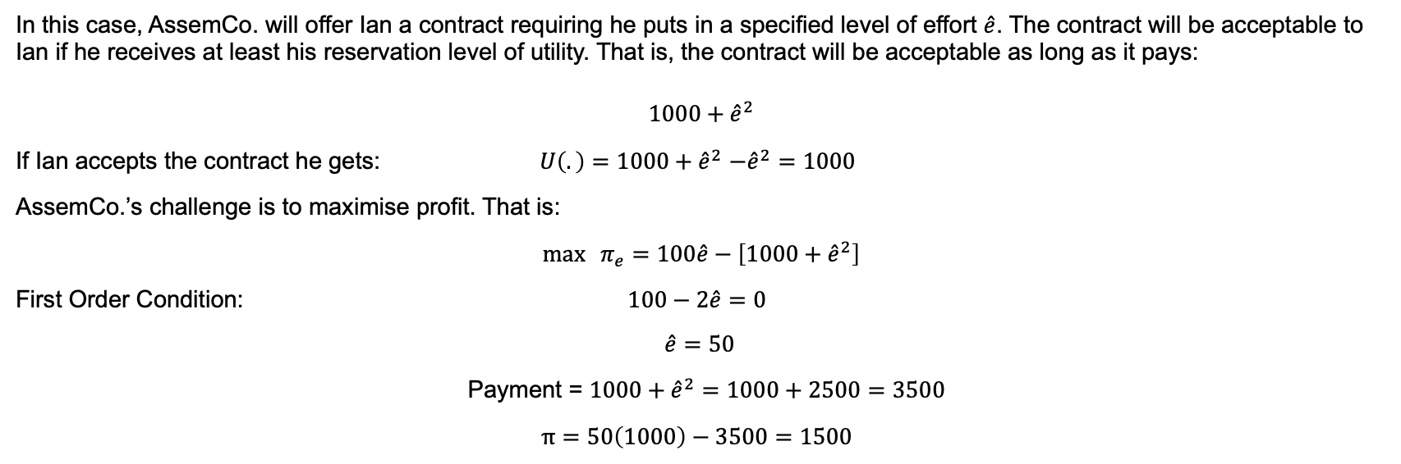
The Basic Incentive Problem
In this case, AssemCo. will offer Ian a contract requiring he puts in a specified level of effort $\hat{e}$. The contract will be acceptable to Ian if he receives at least his reservation level of utility. That is, the contract will be acceptable as long as it pays:
$$1000+{\hat{e}}^{2}$$
If Ian accepts the contract he gets: $U\left(.\right)=1000+{\hat{e}}^{2}$ $−{\hat{e}}^{2}=1000$
AssemCo.’s challenge is to maximise profit. That is:
${\max{π}}_{e}=100\hat{e}−\left[1000+{\hat{e}}^{2}\right]$
First Order Condition: $100−2\hat{e}=0$
$\hat{e}=50$
Payment = $1000+{\hat{e}}^{2}=1000+2500=3500$
$π=50\left(1000\right)−3500=1500$

Slide 6
Benefits & costs ($)
Benefit of effort: $100e
Cost of effort:
$1000 + e²
5000
Firm profit = $1500
3500
1000
e*=50
e (effort)

Slide 7
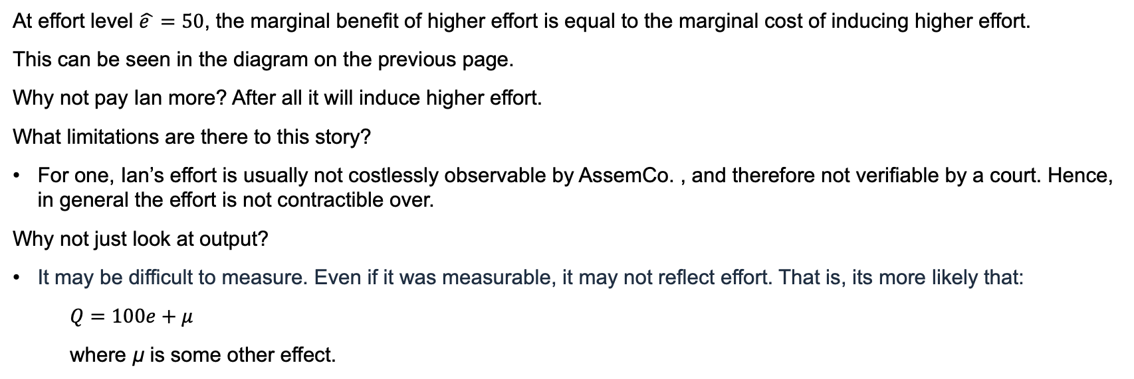
The Basic Incentive Problem
At effort level $\hat{e }=50$, the marginal benefit of higher effort is equal to the marginal cost of inducing higher effort.
This can be seen in the diagram on the previous page.
Why not pay Ian more? After all it will induce higher effort.
What limitations are there to this story?
For one, Ian’s effort is usually not costlessly observable by AssemCo. , and therefore not verifiable by a court. Hence, in general the effort is not contractible over.
Why not just look at output?
It may be difficult to measure. Even if it was measurable, it may not reflect effort. That is, its more likely that:
$Q=100e+μ$
where µ is some other effect.

Slide 8
The Basic Incentive Problem
There are at least three lessons that we can draw:
Incentive problems exist because the interests of the firm/ employer and the employee diverge. The is known as the principal-agent problem.
Incentive conflicts do not cause problems when effort is contractible. With DuPont they could have simply specified the appropriate level of effort for which a bonus was payable if it was the case that the actions of employees were costlessly observable.
In choosing the optimal action the costs to the employee from higher effort and the benefits to the firm in terms of higher profits need to be balanced. Recall we have discussed the idea of compensating differentials previously.

